Slide 1
DEVELOPMENT OF BUS PASS SYSTEM

Slide 2
Student name & prn
Pritesh S. Shetty. 19UCS121
Dhairyashil D. Shinde. 19UCS122
Gouri V. Sonavane. 19UCS127
Gajashree G. Teke. 19UCS129

Slide 3
PROBLEM STATEMENT
To develop a Online Bus Pass system. It provides facility to maintain bus pass information and for user to extend validity when the pass expires.

Slide 4
Introduction
Online Bus Pass System is useful for Passengers who are facing problems with the current manual work of bus pass system and renewal.
Registration process can be done easily though online bus pass system
This Online Bus Pass System application will help candidates to save their time and renewal bus pass without standing in any queue

Slide 5
PROBLEM DESCRIPTION
The Online Bus Pass system automats the conventional process of buying the tickets and standing in long queue for extending validity for their pass. The system has two logins one for user and other for admin. User can refill their account and extend the validity every time the pass expires. Admin can view all users balance and detail through in login.

Slide 6
REQUIREMENTS specification
A) Functional requirements:
No | Requirement | Description
RS1 | The system should have login | When the system is opened a welcome page arrives this welcome page should have login
RS2 | The system should lock id if wrong password is entered in 5 times. | This feature will improve the robustness of application.
RS3 | The system should have help screens | Help about various features of the system should be provided in detail in Q & A format
RS4 | The system should provide date of application of pass and the location for which pass created. | This feature will make the system accurate as this feature can be used by passengers to update with their pass validity

Slide 7
RS5 | System should provide the way to update or renew the pass | This feature will provide passengers to update the location in case or if their validity expires & they want to renew pass.
RS6 | System should provide the period of validity of pass | This feature will make the passengers aware of their last date of validity pass.
RS7 | Passenger should be able to change the password. | This feature increases robustness of system.
RS8 | Admin should be able to check profile & validity of passengers | The system should allow admin to check validity of passengers so that admin can inform passengers to update regarding validity. The system should allow admin to check validity of passengers so that admin can inform passengers to update regarding validity.
RS9 | System should provide the payment option in case the user renews his pass | System gives options to user to make payment by his/her choice.
RS10 | System gives options to user to make payment by his/her choice. | System gives options to user to make payment by his/her choice.

Slide 8
B) Non-functional requirements:
1.Feedback to system by user.
2.The application should be reliable and it should generate all updated information in correct order.
3.Application will be available and working properly for 24hours.
4.The application will be available in all language.

Slide 9
C) Hardware requirements:
Description | Alternatives(if possible)
PC with 5GB hard-disk and 512 MB RAM | Not applicable

Slide 10
D) Software requirements:
Description | Alternatives(if possible)
Windows 7/8/10 with MS- Office | Not applicable
MS-SQL server/Oracle | MS-Access
Linux | Not applicable

Slide 11
Benefits
Time Reducing
Paper work is reduced
Registration of bus pass is easy
Renewal is quickly
It provide easy online payment.

Slide 12
stakeholders
A )User:
i)I should be able to Register in system as passenger.
ii)I should be able to login to the system
iii)I should be able to View my profile
iv)I should be able to Update Personal information.
v) I should be able to Upload documents.
vi) I should be able to do Payment.
vii)I should be able to Request for issuing Bus Pass.
viii)I should be able to give Feedback about service

Slide 13
B) Admin:
i) I should be able to login to the system
I should be able to View my profile.
I should be able to Update Personal information.
I should be able to accept the Request for issuing Bus Pass .
I should be able to check the Validity of passenger’s bus pass .
I should be able to Authenticate the System.
I should be able to Search particular passenger’s profile.viii)
I should be able to do Changes in system

Slide 14
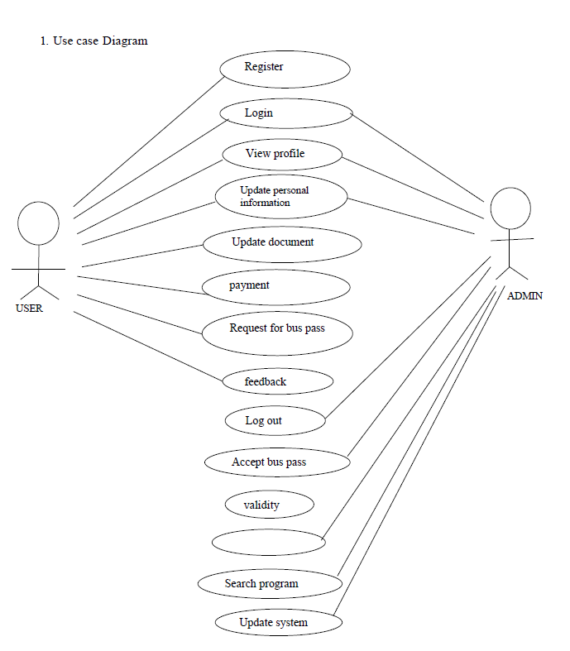
diagrams
DIAGRAMS:
1) User case diagram:
Authentication

Slide 15
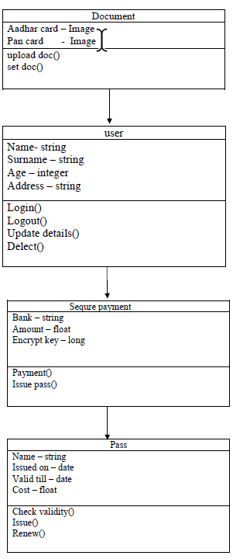
2) Class diagram:

Slide 16
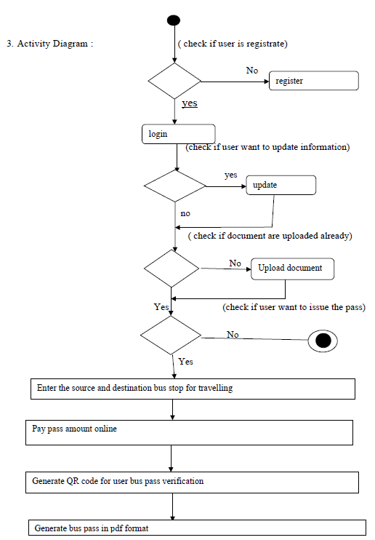
3) Activity diagram:

Slide 17
Test plan
No | Requirement | Description | Expected output
1 | New user registration | Enter all the details of user and check for duplicate entry | User registered
2 | System login | Enter user name | Successful login
3 | Unsuccessful user verification due to wrong password | Login to the system with wrong password | Unsuccessful login
4 | Unsuccessful user verification due to invalid login id | Login to the system with a invalid login id | Invalid user id
5 | Generate pass | Generate bus pass With Validity of pass | Bus pass generated
6 | Take payment | Enter amount | Payment received
7 | Feedback | User can add feedback about bus pass system | Feedback received

Slide 18
Thank you

